Slide 1




PIG, HIVE, IMPALA, AVRO
Presented By:
Prateek Gangwal
Sakshi Arora
Praneeth Bellamkonda

Slide 2
RDBMS
PIG
HBase
MAHOUT
SQOOP
HIVE
MAP REDUCE
HDFS

Slide 3
PIG

Slide 4
What is PIG?
Pig is a simple-to-understand data flow language used in the analysis of large data sets
Pig scripts are automatically converted into MapReduce jobs by the Pig interpreter, so you can analyze the data in a Hadoop cluster even if you aren't familiar with MapReduce

Slide 5
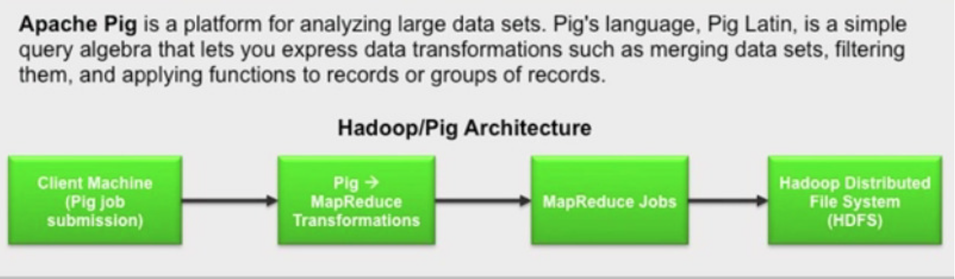

Slide 6
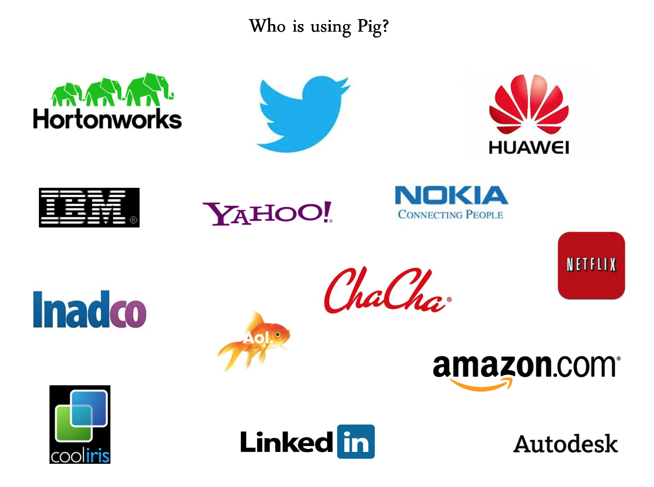
Users of PIG
Yahoo is one of the heaviest user of hadoop, runs 40% of all its hadoop jobs using PIG

Slide 7
How to access PIG?
Grunt, Pig shell
Submit the PIG scripts directly
Pig server JAVA class, a JDBC like interface
Pig Pen, an eclipse plugin

Slide 8
Pig Data Types
Scalar Types:
Int
Long
Chararray
Bytearray
Complex Types:
Tuple
Bag

Slide 9
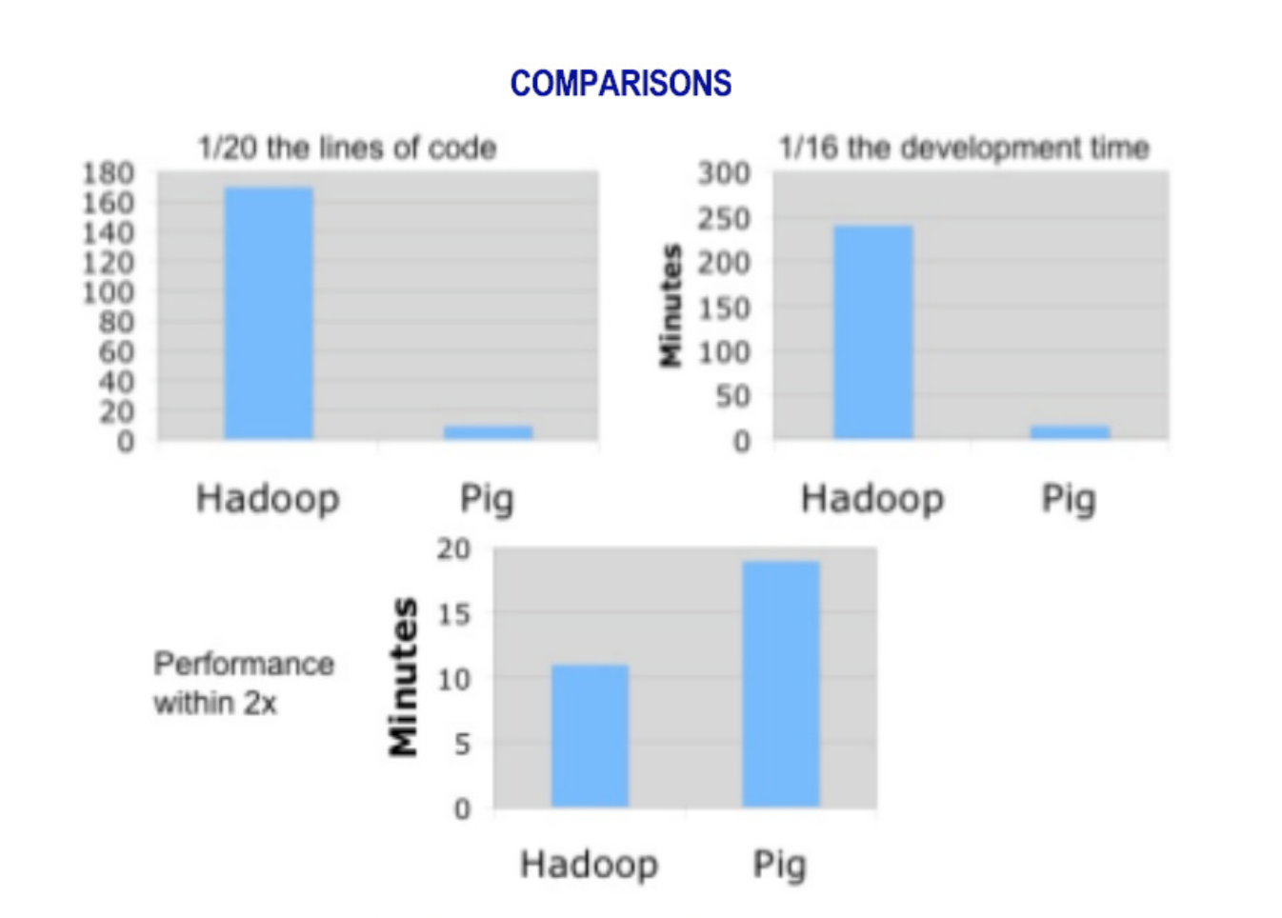
Why do we use PIG
PIG is a data flow scripting language, used for performing map reduce task

Slide 10
How to load the data in PIG?
We have few data loaders available in PIG:
Pig Storage: load/stores relations using field-delimited text format
JSON loader: load/stores relation which are in JSON format
Bin Storage: load/stores relations from binary files

Slide 11
We need to start the PIG Shell
We can run PIG shell in two modes:
Local mode
MapReduce mode (on the HDFS)
Command to dive into PIG
./pig –x local (for the local mode)
./pig –x mapreduce (for the distributed mode)

Slide 12
Load returns a Tuple
Load statement returns a tuple. Each tuple has multiple elements, which can be referenced by position or by name
When you perform a DUMP of the contents, there are normally multiple tuples which is displayed

Slide 13
Some of the operations in PIG
LOAD
LIMIT
DUMP
STORE
DESCRIBE
AVG
CONCAT
COUNT
MIN
MAX
FILTER
JOIN
GROUP BY
ORDER BY

Slide 14
User Define Functions - UDF
Pig supports the concept of UDF

Slide 15
DEMO
Customer Data set given
Map reduce to find the most purchased mobile using PIG

Slide 16
HIVE

Slide 17
Hive Origin
Started at Facebook to manage lots of data
The data was stored in Oracle every night
Exponential growth in the data
By 2006, 1 TB /day
By 2010, 10 TB/day
By 2013 about 500.000.000 logs per day
There was a need to find some way to manage data “effectively’.

Slide 18
What is Hive?
Hive is a data warehouse infrastructure built on top of Hadoop that can compile SQL queries a MapReduce jobs and run the jobs in the cluster.
What is DW(Data Warehouse)?
A data warehouse is a database specific for analysis and reporting purposes.

Slide 19
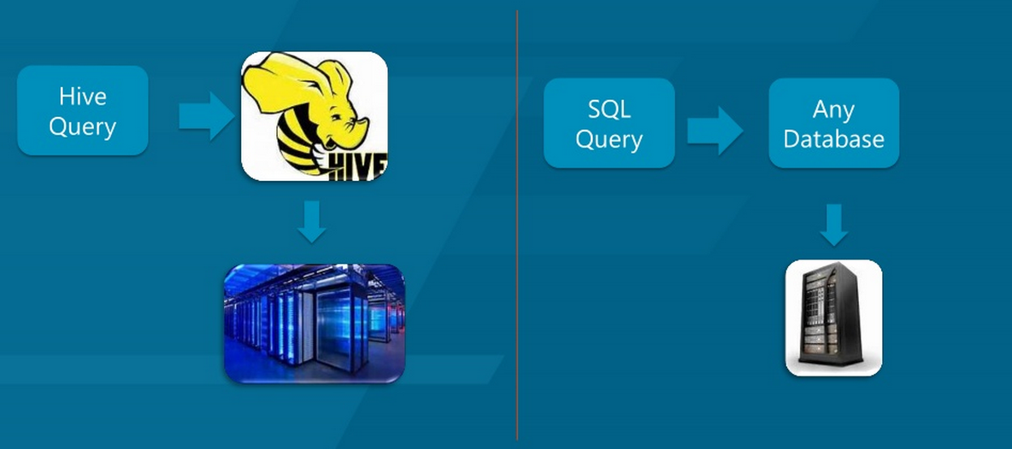
Hive Vs. Simple Web App

Slide 20
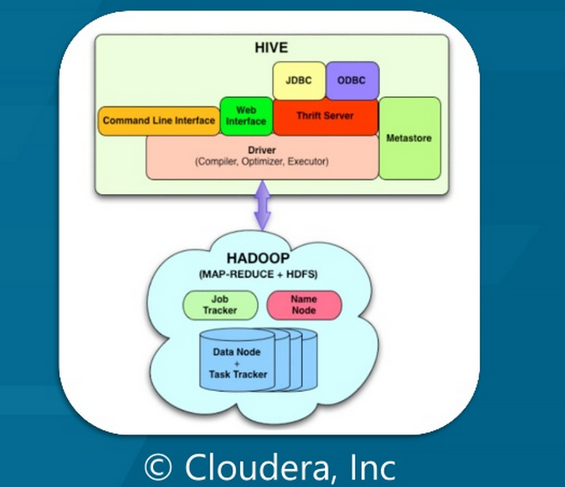
Hive Architecture

Slide 21
Hive Architecture
External Interface
CLI
Web UI
API
JDBC and ODBC Server
Thrift Server
Client API to execute HiveQL Statement
Metastore
System Catalog
All components of Hive interact with Metastore

Slide 22
Hive Database
Data Model
Query Language

Slide 23
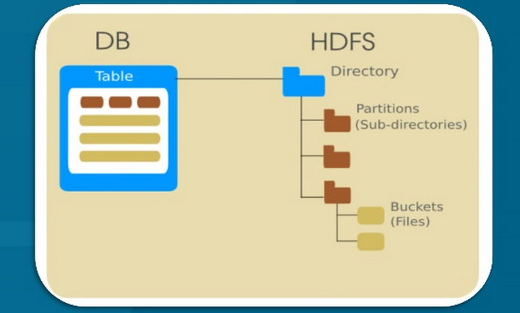
Data Model
Hive structures data into a well defined concept i.e. tables, columns and rows, partitions, buckets etc.

Slide 24
Hive Data Model
Tables
Type of columns (int, float, string, date, Boolean)
Supports array/map/struct for JSON like data
Partitions
i.e. range partition tables by date
Buckets
Hash partition within ranges
Useful for sampling, join optimization

Slide 25
Metastore
Database
Namespace containing a set of tables
Table
Contain a list of columns and types of SerDe Info.
Partition
Each partition can have its own columns, SerDe and storage info
Mapping to HDFS directories
Statistics
Info about the database

Slide 26
Hive Vs. RDBMS
Hive | RDBMS
Supports distributed Architecture | Supports client-server Architecture
Verifying schema on Read | Verifying schema on write
Implementation of user defined functions | Can’t implement used defined functions
Arbitrary insert and update is not possible | Arbitrary insert and update is possible

Slide 27
IMPALA

Slide 28
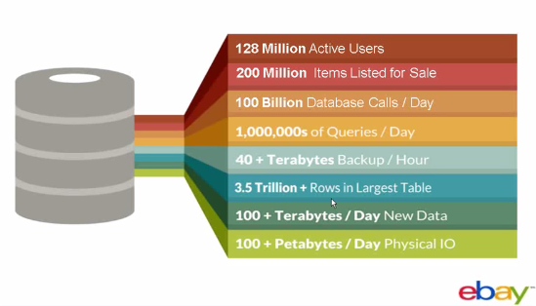
Scale at eBay

Slide 29
Big Questions ?
How to run analytical queries over Peta Bytes of data in near real-time?
Example: A Seller want to know which city in Texas bought most from them?
How to achieve the low-latency response with minimal effort?
Is there any cost-effective solution available to run the analytical queries?

Slide 30
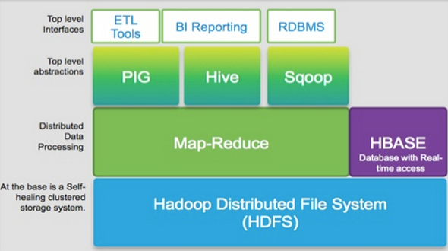
Question ?
If I have 10TB of data in my HDFS what are the options I have to process the data?
Map-reduce
Hive
PIG
Any major performance gain?

Slide 31
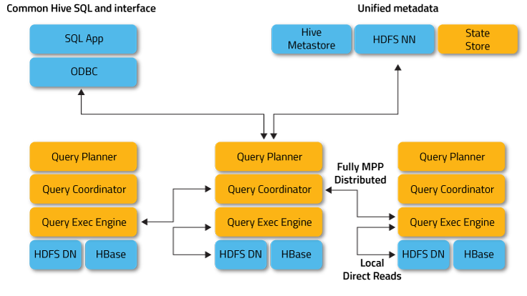
Impala – Architecture

Slide 32
Impala – Architecture
Impala Daemon
runs on every node
handles client requests
handles query planning & execution
State Store Daemon
provides name service
metadata distribution
used for finding data

Slide 33
Impala – Architecture
SQL App
Hive Metastore
HDFS NN
Statestore
ODBC
Impalad continually talks to statestore to update their state and to receive metadata to use for query planning
Query Planner
Query Planner
Query Planner
Query Coordinator
Query Coordinator
Query Coordinator
Query Executor
Query Executor
Query Executor
HDFS DN
HBase
HDFS DN
HBase
HDFS DN
HBase

Slide 34
Why Impala?
Interactive SQL
In-memory Distributed SQL Query Engine.
Built for low-latency (real-time) analytics query.
Highly Scalable
Built on top of Hadoop
Simply scales by just adding nodes.
Direct access to data in HDFS/Hbase (no map-reduce)
Easy to use
Minimal data transformation effort required.
Re-uses hive metastore.
Easy to integrate. Supports JDBC client

Slide 35
Impala Query Execution
1) Request arrives via ODBC/JDBC/HUE/Shell
SQL App
Hive Metastore
HDFS NN
Statestore
ODBC
SQL request
Query Planner
Query Planner
Query Planner
Query Coordinator
Query Coordinator
Query Coordinator
Query Executor
Query Executor
Query Executor
HDFS DN
HBase
HDFS DN
HBase
HDFS DN
HBase

Slide 36
Impala Query Execution
2) Planner turns request into collections of plan fragments
3) Coordinator initiates execution on impalad(s) local to data
SQL App
Hive Metastore
HDFS NN
Statestore
ODBC
Query Planner
Query Planner
Query Planner
Query Coordinator
Query Coordinator
Query Coordinator
Query Executor
Query Executor
Query Executor
HDFS DN
HBase
HDFS DN
HBase
HDFS DN
HBase

Slide 37
Impala Query Execution
4) Intermediate results are streamed between impalad(s)
5) Query results are streamed back to client
SQL App
Hive Metastore
HDFS NN
Statestore
ODBC
Query Planner
Query Planner
Query Planner
Query Coordinator
Query Coordinator
Query Coordinator
Query Executor
Query Executor
Query Executor
HDFS DN
HBase
HDFS DN
HBase
HDFS DN
HBase

Slide 38

Features from relational databases or Hive are not available in Impala?
Querying streaming data.
Deleting individual rows. You delete data in bulk by overwriting an entire table or partition, or by dropping a table.
Indexing (not currently).
Custom Hive Serializer/Deserializer classes (SerDes)
Check pointing within a query. That is, Impala does not save intermediate results to disk during long-running queries.

Slide 39
Features from relational databases or Hive are not available in Impala?
Data is immutable, no updating
High memory usage
Response time is seconds not microseconds
Non-scalar data types such as maps, arrays, structs
XML and JSON functions

Slide 40
AVRO

Slide 41
What is Avro?
Avro is an apache open source project that provides two services for Hadoop:
Data Serialization
Data Deserialization
We can use this services together or independently

Slide 42
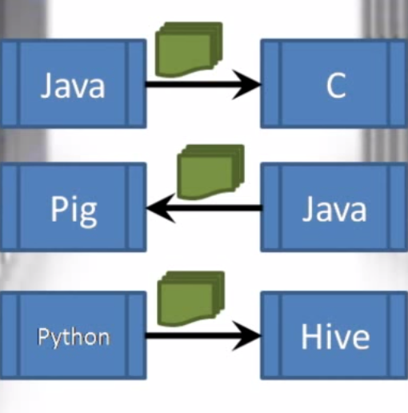
Data stored using Avro can easily be passed from a program written in one language to a program written in another language, even from a complied language like C to a scripting language like PIG

Slide 43
Avro stores the data into very compact and efficient format. It stores both the data definition and the data together in one message or file
The data definition is stored in JSON format and the data is stored in binary format
Example:

Slide 44
Avro supports a rich set of primitive data types including: numeric, binary and strings
It also supports number of complex data types such as arrays, maps, enumerations and records
Avro includes the API for Java, Python, Ruby, C, C++ and more

Slide 45
Existing Serialization Systems: Protocol Buffers and Thrift
Expressive
Efficient (small and fast)
But these are not very dynamic
Cannot browse arbitrary data
Viewing a new data type or writing a new data type requires code generation

Slide 46
Avro Serialization
It has a simple schema, and the schema language is in JSON format
Every time you do a serialization or deserialization (read or write) the schema is present
Code generation is optional

Slide 47
Schema and Code generation
{"namespace": "example.avro",
"type": "record",
"name": "User",
"fields": [
{"name": "name", "type": "string"},
{"name": "favorite_number", "type": ["int", "null"]},
{"name": "favorite_color", "type": ["string", "null"]} ] }
Code generation allows us to automatically create classes based on our previously-defined schema

Slide 48
First let's create some Users and set their fields.
User user1 = new User(); user1.setName("Alyssa"); user1.setFavoriteNumber(256);
// Leave favorite color null
Now once the user is created and the fields are set we can perform the serialization and the deserialization for the user objects created

Slide 49
Avro MapReduce API
Unlike the normal hadoop MapReduce the Avro API is slightly different
public void map(LongWritable key, Text value, OutputCollector<Text, IntWritable> output, Reporter reporter) throws IOException {}
Arvo MapReduce
map(IN, Collector<Pair<K,V>>)
So the key value is generated at the intermediate step i.e. the output of map and the input of the reducer

Slide 50
References
Cloudera Impala official documentation and slides
http://www.cloudera.com/content/cloudera/en/documentation/core/latest/topics/impala.html
Stack Overflow: http://stackoverflow.com/search?q=impala
Quora: http://www.quora.com/Cloudera-Impala
http://impala.io/index.html

